Slide 1
Multi-Tenant Architecture
Considerations for FIS

Slide 2
Definition
Multi-tenancy is an architecture in which a single instance of a software application serves multiple customers. Each customer is called a tenant.
Eg. FIS will be a multi-tenant system and StarBucks / Dominos will the tenants

Slide 3
FIS Needs
Each tenant will have individual look & feel (branding)
Each tenant will have internal business workflows in addition to certain generic ones
System needs to have defense in depth security
Data structure should be customizable on per-tenant basis
Database structure should have minimum maintenance overhead

Slide 4
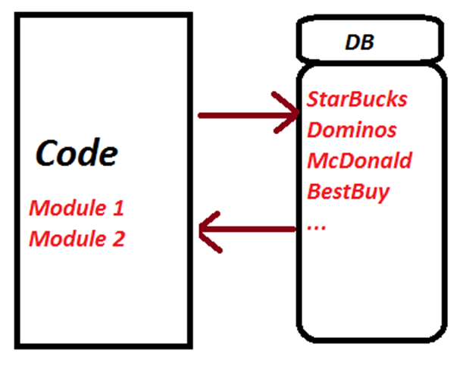
Before Multi-Tenant
All data/business logic/configuration in same system Specific customer demands collide with other customers No per-tenant scalability Any changes require maintaining separate branches for code and database

Slide 5

Various Approaches to MTA
Separate DB per tenant
Physical isolation
High cost of maintenance (license, admin costs)
Separate schema per tenant, but shared DB
Logical isolation, single or cluster physical deployment
Present study explored this approach
Shared schema with each tenant within a shared DB
Tenant-identifier selects the specific records

Slide 6
Approach explored
Main deployment common, tenant specific components get loaded as “plugins” based on configuration/license
Underlying data-store separated logically through individual “schemas” and physically through individual instance/server.
Each tenant can scale as no dependency on other tenants

Slide 7
Post Multi-Tenant
Plugins make system infinite scalable both on core/specific functionality Tenant-specific DB separation allow security DI tool to load modules based on tenant’s license All changes scoped to module in app and specific table in consuming tenant’s DB

Slide 8
Release and Deployment in MTA
Change Management Concerns
Tenant specific branding
Tenant specific feature request
Global changes (bug-fix, legal, business updates)
Versioning

Slide 9
Release and Deployment in MTA
Resolution (approach explored)
All branding configuration with tenant-identifier
Specific feature request
Application: “Decorator” over existing module, loaded using “Dependency Injection”
Database: Schema isolation allows any modification
Each module will be deployed as Service Endpoint, with different versions consumed by different tenants

Slide 10
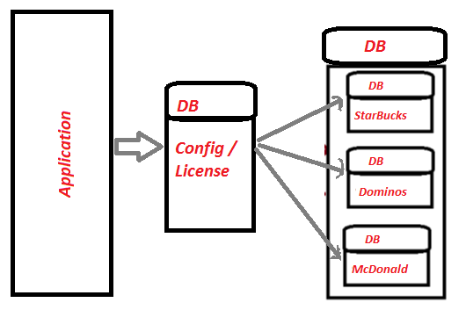
Approach’s Deployment
Configuration data in separate DB Each tenant to have dedicated:- Schema Login / Users Tables SP / Functions User’s security token decides which tenant to invoke

